Slide 1

Learning Constraints for Personnel Rostering Problems Using Tensors
Mohit Kumar

Slide 2
Background
Started Pre-Doctoral
May’17
Started PhD
Oct’17
First Oral Presentation
July’18
Tutor for the course: Uncertainty in AI
Blueprint
Academic writing
Declarative Talen en AI
Summer School

Slide 3
Overview
Problem Introduction
Algorithm – COUNT-OR
Experiments
Results
Submissions
Future Work

Slide 4
Problem Introduction

Slide 5
Objective
 | Mon |  |  | Tue |  |  | -
Nurse | S1 | S2 | S3 | S1 | S2 | S3 | - | - | -
Sophie | 1 | 0 | 1 | 0 | 0 | 0 | - | - | -
Hanna | 0 | 1 | 0 | 0 | 0 | 0 | - | - | -
Ruben | 1 | 0 | 1 | 0 | 0 | 0 | - | - | -
Sam | 0 | 0 | 0 | 1 | 0 | 0 | - | - | -
Constraints
Max/Min number of working days
Max/Min number of employees each day/shift
Max/Min number of consecutive working days
Max/Min number of shifts per day
COUNT-OR

Slide 6

Why is it useful?
Removes the dependency on domain experts
Saves a lot of time and money
Reduces the chances of making any error
Notes:
For big organizations, generating schedules manually is a complicated task, having a constraint learner removes the dependency on domain experts and thus saves a lot of time and money, and at the same time reduces the chances of making any error

Slide 7
Algorithm – COUNT-OR

Slide 8
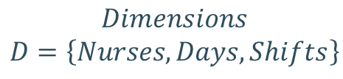
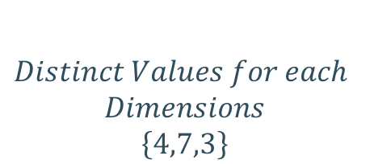
Data Representation
Rank
$$Dimensions$$
$$D=\left\{Nurses,Days,Shifts\right\}$$
 | Mon |  |  | Tue |  |  | -
Nurse | S1 | S2 | S3 | S1 | S2 | S3 | - | - | -
Sophie | 1 | 0 | 1 | 0 | 0 | 0 | - | - | -
Hanna | 0 | 1 | 0 | 0 | 0 | 0 | - | - | -
Ruben | 1 | 0 | 1 | 0 | 0 | 0 | - | - | -
Sam | 0 | 0 | 0 | 1 | 0 | 0 | - | - | -
X
$$Distinct Values for each$$
$$Dimensions$$
$$\left\{4,7,3\right\}$$
Shape

Slide 9

Tensor Slices
$$D′=\left\{Nurses,Days\right\}$$
 | Mon |  |  | Tue |  |  | -
Nurse | S1 | S2 | S3 | S1 | S2 | S3 | - | - | -
Sophie | 1 | 0 | 1 | 0 | 0 | 0 | - | - | -
Hanna | 0 | 1 | 0 | 0 | 0 | 0 | - | - | -
Ruben | 1 | 0 | 1 | 0 | 0 | 0 | - | - | -
Sam | 0 | 0 | 0 | 1 | 0 | 0 | - | - | -

Slide 10

Tensor Slices
$$D′=\left\{Shifts,Days\right\}$$
 | Mon |  |  | Tue |  |  | -
Nurse | S1 | S2 | S3 | S1 | S2 | S3 | - | - | -
Sophie | 1 | 0 | 1 | 0 | 0 | 0 | - | - | -
Hanna | 0 | 1 | 0 | 0 | 0 | 0 | - | - | -
Ruben | 1 | 0 | 1 | 0 | 0 | 0 | - | - | -
Sam | 0 | 0 | 0 | 1 | 0 | 0 | - | - | -

Slide 11

Tensor Slices
$$D′=\left\{Days\right\}$$
 | Mon |  |  | Tue |  |  | -
Nurse | S1 | S2 | S3 | S1 | S2 | S3 | - | - | -
Sophie | 1 | 0 | 1 | 0 | 0 | 0 | - | - | -
Hanna | 0 | 1 | 0 | 0 | 0 | 0 | - | - | -
Ruben | 1 | 0 | 1 | 0 | 0 | 0 | - | - | -
Sam | 0 | 0 | 0 | 1 | 0 | 0 | - | - | -

Slide 12
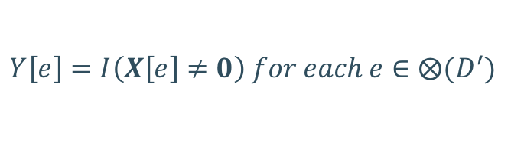
Function Definitions – NonZero
$$D′=\left\{Nurses,Days\right\}$$
 | Mon |  |  | Tue |  |  | -
Nurse | S1 | S2 | S3 | S1 | S2 | S3 | - | - | -
Sophie | 1 | 0 | 1 | 0 | 0 | 0 | - | - | -
Hanna | 0 | 1 | 0 | 0 | 0 | 0 | - | - | -
Ruben | 1 | 0 | 1 | 0 | 0 | 0 | - | - | -
Sam | 0 | 0 | 0 | 1 | 0 | 0 | - | - | -
$$Y\left[e\right]=I\left(X\left[e\right]≠0\right) for each e∈⨂(D^{′})$$

Slide 13
Function Definitions – NonZero
$$D′=\left\{Nurses,Days\right\}$$
 | Mon |  |  | Tue |  |  | -
Nurse | S1 | S2 | S3 | S1 | S2 | S3 | - | - | -
Sophie | 1 |  |  | 0 |  |  | - | - | -
Hanna | 1 |  |  | 0 |  |  | - | - | -
Ruben | 1 |  |  | 0 |  |  | - | - | -
Sam | 0 |  |  | 1 |  |  | - | - | -
$$Y\left[e\right]=I\left(X\left[e\right]≠0\right) for each e∈⨂(D^{′})$$

Slide 14
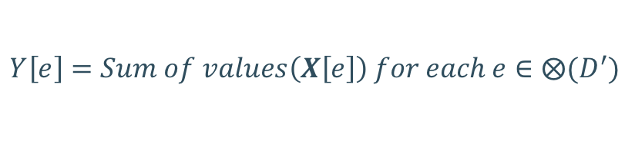
Function Definitions – Sum
$$D′=\left\{Nurses,Days\right\}$$
 | Mon |  |  | Tue |  |  | -
Nurse | S1 | S2 | S3 | S1 | S2 | S3 | - | - | -
Sophie | 1 | 0 | 1 | 0 | 0 | 0 | - | - | -
Hanna | 0 | 1 | 0 | 0 | 0 | 0 | - | - | -
Ruben | 1 | 0 | 1 | 0 | 0 | 0 | - | - | -
Sam | 0 | 0 | 0 | 1 | 0 | 0 | - | - | -
$$Y\left[e\right]=Sum of values\left(X\left[e\right]\right) for each e∈⨂(D^{′})$$

Slide 15
Function Definitions – Sum
$$D′=\left\{Nurses,Days\right\}$$
 | Mon |  |  | Tue |  |  | -
Nurse | S1 | S2 | S3 | S1 | S2 | S3 | - | - | -
Sophie | 2 |  |  | 0 |  |  | - | - | -
Hanna | 1 |  |  | 0 |  |  | - | - | -
Ruben | 2 |  |  | 0 |  |  | - | - | -
Sam | 1 |  |  | 1 |  |  | - | - | -
$$Y\left[e\right]=Sum of values\left(X\left[e\right]\right) for each e∈⨂(D^{′})$$

Slide 16




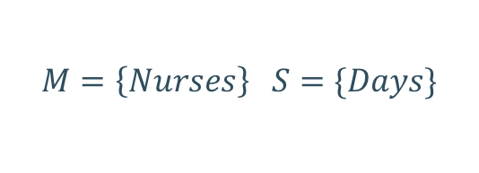
Function Definitions – Count
$$M$$
$$M=\left\{Nurses\right\} S=\{Days\}$$
$$D$$
$$M∩S=∅$$
$$S$$
 | Mon |  |  | Tue |  |  | -
Nurse | S1 | S2 | S3 | S1 | S2 | S3 | - | - | -
Sophie | 1 | 0 | 1 | 0 | 0 | 0 | - | - | -
Hanna | 0 | 1 | 0 | 0 | 0 | 0 | - | - | -
Ruben | 1 | 0 | 1 | 0 | 0 | 0 | - | - | -
Sam | 0 | 0 | 0 | 1 | 0 | 0 | - | - | -
$$COUNT\left(X,M,S\right)=Sum(NonZero\left(X,M∪S\right),S)$$

Slide 17
Function Definitions – Count
$$M=\left\{Nurses\right\} S=\{Days\}$$
 | Mon |  |  | Tue |  |  | -
Nurse | S1 | S2 | S3 | S1 | S2 | S3 | - | - | -
Sophie | 1 |  |  | 0 |  |  | - | - | -
Hanna | 1 |  |  | 0 |  |  | - | - | -
Ruben | 1 |  |  | 0 |  |  | - | - | -
Sam | 0 |  |  | 1 |  |  | - | - | -
$$COUNT\left(X,M,S\right)=Sum(NonZero\left(X,M∪S\right),S)$$

Slide 18
Function Definitions – Count
$$M=\left\{Nurses\right\} S=\{Days\}$$
 | Mon |  |  | Tue |  |  | -
Nurse | S1 | S2 | S3 | S1 | S2 | S3 | - | - | -
Sophie | 1 |  |  | 0 |  |  | - | - | -
Hanna | 1 |  |  | 0 |  |  | - | - | -
Ruben | 1 |  |  | 0 |  |  | - | - | -
Sam | 0 |  |  | 1 |  |  | - | - | -
$$COUNT\left(X,M,S\right)=Sum(NonZero\left(X,M∪S\right),S)$$

Slide 19
Function Definitions – Count
$$M=\left\{Nurses\right\} S=\{Days\}$$
 | Mon |  |  | Tue |  |  | -
Nurse | S1 | S2 | S3 | S1 | S2 | S3 | - | - | -
Count | 3 |  |  | 1 |  |  | - | - | -
$$COUNT\left(X,M,S\right)=Sum(NonZero\left(X,M∪S\right),S)$$

Slide 20
Constraints List
M | S | Count
{Days} | {Nurses} | # of working days/Nurse
{Days, Shifts} | {Nurses} | # of working shifts/Nurse
{Days} | {Nurses} | # of employees / day
{Shifts} | {Days} | # of shifts for each day with at least one nurse working
{Slots} | {Nurses, Days} | # of working shifts per day / nurse
{Days} | {Nurses, Slots} | # of working days in the same shift / nurse
{Nurses} | {Days, Shifts} | # of nurses pre shift per day
$$COUNT\left(X,M,S\right)=Sum(NonZero\left(X,M∪S\right),S)$$

Slide 21
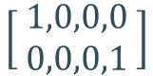
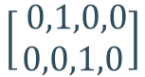
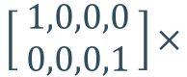
Background Knowledge
 | Mon
Nurse | S1 | S2 | S3
Sophie | 1 | 0 | 1
Hanna | 0 | 1 | 0
Ruben | 0 | 0 | 1
Sam | 0 | 0 | 0
Tue
S1 | S2 | S3
0 | 1 | 0
0 | 1 | 0
0 | 0 | 1
0 | 0 | 0
Nurses | Skill Level
Sophie | High
Hanna | Low
Ruben | Low
Sam | High
$$\left[1,0,0,1\right]$$
$$\left[ \begin{aligned}1,0,0,0 \\ 0,0,0,1 \end{aligned}\right]$$
$$\left[ \begin{aligned}1,0,0,0 \\ 0,0,0,1 \end{aligned}\right]×$$
H
L
$$\left[0,1,1,0\right]$$
$$\left[\begin{aligned} 0,1,0,0 \\ 0,0,1,0\end{aligned}\right]$$
 | Mon
Nurse | S1 | S2 | S3
Sophie | 1 | 0 | 1
Sam | 0 | 0 | 0
Tue
S1 | S2 | S3
0 | 1 | 0
0 | 0 | 0

Slide 22
Experiments

Slide 23
Questions
Does the learned model produce schedules similar to the target model?
How many input examples are needed to achieve a good accuracy?
Does the algorithm scale to real world target models?
How does the algorithm perform in the presence of the background knowledge?

Slide 24
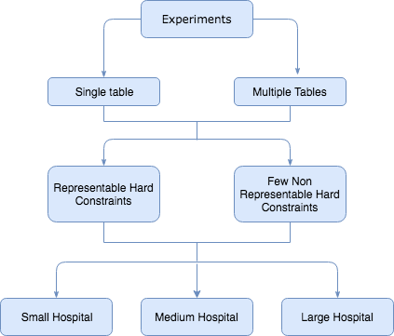
Experiments
Generate Solutions
Learn Model
Precision & Recall
Target Model

Slide 25
Results

Slide 26
Results – Representable Hard Constraint

Slide 27
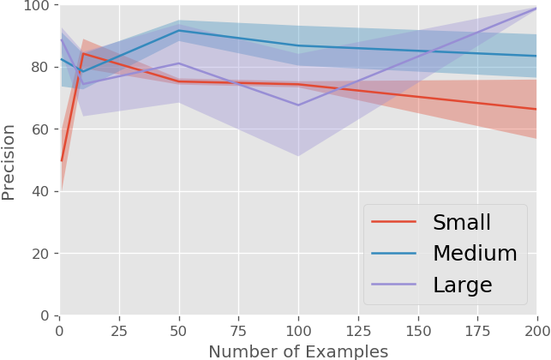
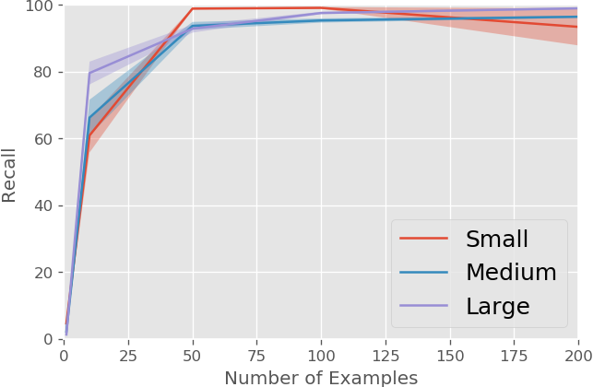
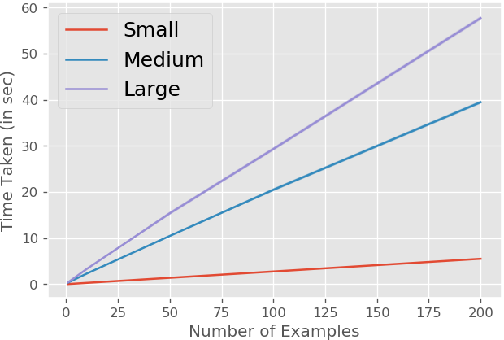
Results – Non-Representable Hard Constraint

Slide 28
Submissions & Future Work

Slide 29
Submissions
Abstract accepted in EURO 2018 – 29th European Conference on Operational Research
Workshop paper accepted at IJCAI 2018 – Data Science meets Optimization
Decomposition Strategies for Constructive Preference Elicitation accepted at the Thirty-Second AAAI Conference on Artificial Intelligence (AAAI-18)

Slide 30

Future Work
Extend the algorithm to support other problems
like Sports scheduling or time tabling
Make the algorithm interactive by including the concept of coactive learning
Careful omission of constraints because the set of constraints learnt with COUNT-OR is bigger than the target model
Handling soft constraints as they appear quite frequently in OR models

Slide 31
THANK YOU

Slide 32
QUESTIONS ?

